Slide 1


POWER CONSUMPTION ANALYSIS FOR HOUSE HOLDS
GUIDED BY
PRADEEPTHI MAM.
Presented By
MIND OPTIMISERS
CSE 3rd year

Slide 2
INDEX
Study present energy consumption
Define the scope for saving
Identify most likely & easiest areas for attention
Identify immediate no or low-cost improvements
Set a 'reference point‘
Identify areas for more detailed study
Use existing or easily obtained data

Slide 3
Sr. no | Appliance | No. of appliances | Hours in use | Watt | Kwh
1 | Tube Light | 3 | 6 | 20*3=60 | 0.36
2 | Bulb | 3 | 0.5 | 100*3=300 | 0.15
3 | CFL | 1 | 4 | 15 | 0.06
4 | Fan | 2 | 3 | 50*2=100 | 0.3
5 | Refrigerator | 1 | 24 | 110 | 2.64
6 | Washing machine | 1 | 0.50 | 200 | 0.06
7 | Geyser | 1 | 0.50 | 3000 | 1.5
8 | Laptop | 1 | 1 | 80 | 0.08
9 | TV | 1 | 4.5 | 98 | 0.441
10 | Charger | 2 | 2 | 3*2=6 | 0.012
11 | Mixer | 1 | 0.08 | 200 | 0.016
12 | Iron | 1 | 0.08 | 550 | 0.044
 |  |  |  | Total kwh/day | 5.663
 |  |  |  | Kwh/month | 169.89

Slide 4
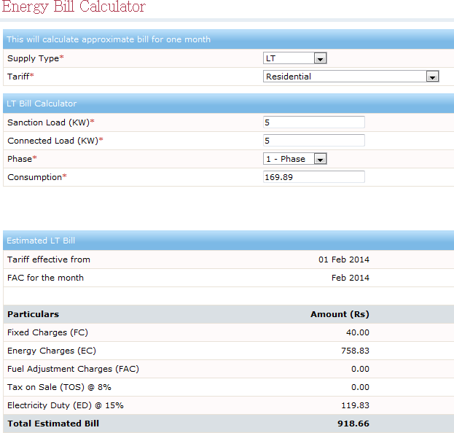
[1]
01 Feb 2020
Feb 2020

Slide 5
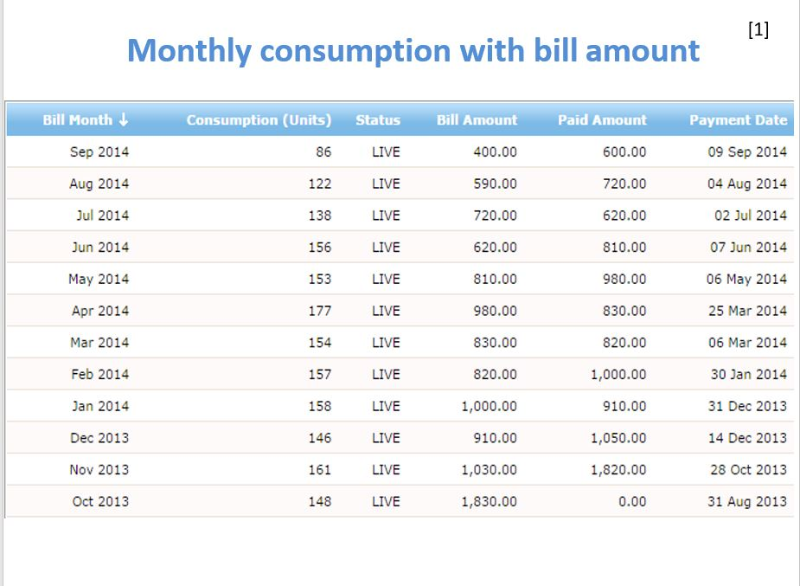
Sep 2020
09Sep 2020
Aug 2020
04Aug 2020
Jul 2020
02Jul 2020
Jun 2020
07Jun 2020
May 2020
06May 2020
Apr 2020
25Mar 2020
Mar 2020
06Mar 2020
Feb 2020
30Jan 2020
Jan 2020
31Dec 2020
Dec 2019
14Dec 2019
Nov 2019
28Oct 2019
Oct 2019
31Aug 2019

Slide 6
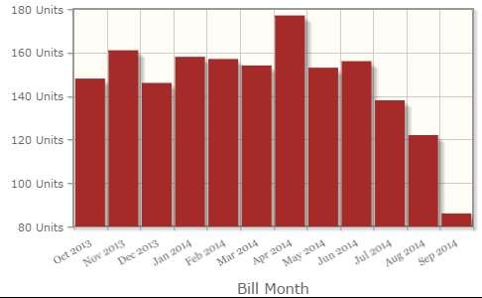
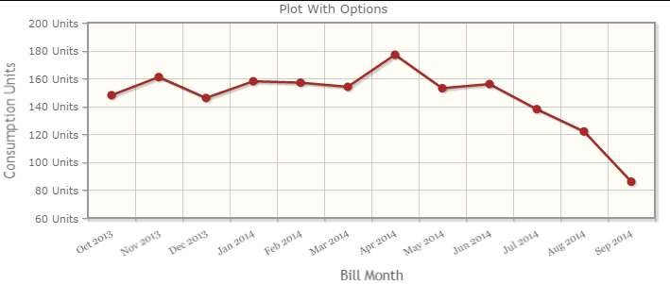
Monthly consumption with bill amount
[1]
Oct Nov Dec Jan Feb Mar Apr May Jun Jul Aug Sep
Oct Nov Dec Jan Feb Mar Apr May Jun Jul Aug Sep

Slide 7
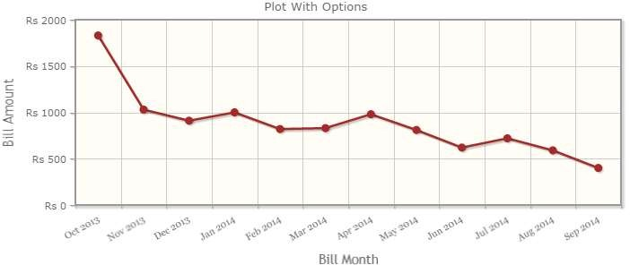
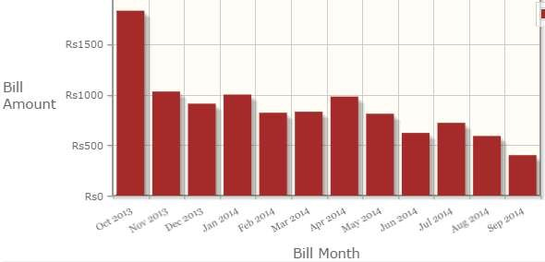
[1]
Oct Nov Dec Jan Feb Mar Apr May Jun Jul Aug Sep
Oct Nov Dec Jan Feb Mar Apr May Jun Jul Aug Sep

Slide 8
Scope for saving energy consumption
As per given energy consumed by appliances and available options, the areas of concentrations are-
TV
BULBS
REFRIGERATOR
GEYSER
FANS

Slide 9
No investment measures
Sr. no | Appliance | No. of appliances | Hours in use | Watt | Kwh
1 | Tube Light | 3 | 4 | 20*3=60 | 0.24
2 | Bulb | 3 | 0.5 | 100*3=300 | 0.15
3 | CFL | 1 | 4 | 15 | 0.06
4 | Fan | 2 | 2 | 50*2=100 | 0.2
5 | Refrigerator | 1 | 24 | 110 | 2.64
6 | Washing machine | 1 | 0.50 | 200 | 0.06
7 | Geyser | 1 | 0.50 | 3000 | 1.5
8 | Laptop | 1 | 0.5 | 80 | 0.04
9 | TV | 1 | 3 | 98 | 0.294
10 | Charger | 2 | 2 | 3*2=6 | 0.012
11 | Mixer | 1 | 0.08 | 200 | 0.016
12 | Iron | 1 | 0.08 | 550 | 0.044
 |  |  |  | Total kwh/day | 5.256
 |  |  |  | Kwh/month | 157.68

Slide 10
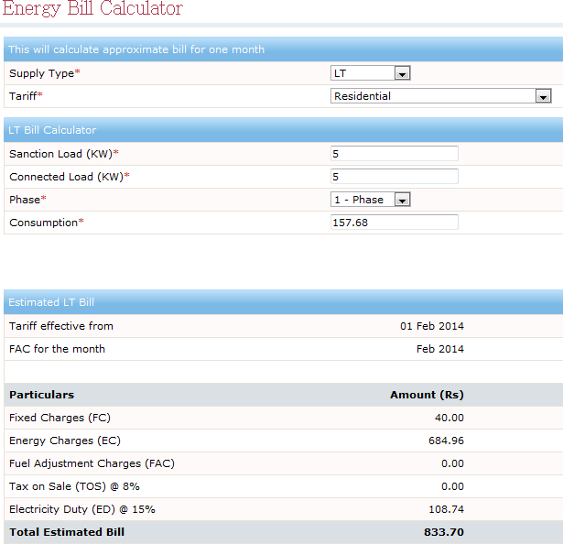
[1]
01 Feb 2020
Feb 2020

Slide 11
Low investment measures
CFL instead of bulbs [4] Price – Rs. 120 to 400
Gas geyser instead of electric heater Price- Rs. 4200
Running cost- Rs.150 per month
Table fan [5]
Price- Rs. 1400/-
Sr no. | Appliances | Watts | Appliances | Watts
1 | Gas Geyser | - | Electric geyser | 3000
2 | CFL | 20 | Bulb | 100
4 | Table fan | 40 | Ceiling fan | 50

Slide 12
Low investment
Sr. no | Appliance | No. of appliances | Hours in use | Watt | Kwh
1 | Tube Light | 3 | 4 | 20*3=60 | 0.24
2 | CFL | 3 | 4 | 20*3=60 | 0.24
3 | CFL | 2 | 0.5 | 8*2=16 | 0.008
4 | Fan | 2 | 2 | 50*2=100 | 0.2
5 | Refrigerator | 1 | 24 | 110 | 2.64
6 | Washing machine | 1 | 0.50 | 200 | 0.06
7 | Laptop | 1 | 0.5 | 80 | 0.04
8 | TV | 1 | 3 | 98 | 0.294
9 | Charger | 2 | 2 | 3*2=6 | 0.012
10 | Mixer | 1 | 0.08 | 200 | 0.016
11 | Iron | 1 | 0.08 | 550 | 0.044
 |  |  |  | Total kwh/day | 3.794
 |  |  |  | Kwh/month | 113.82

Slide 13
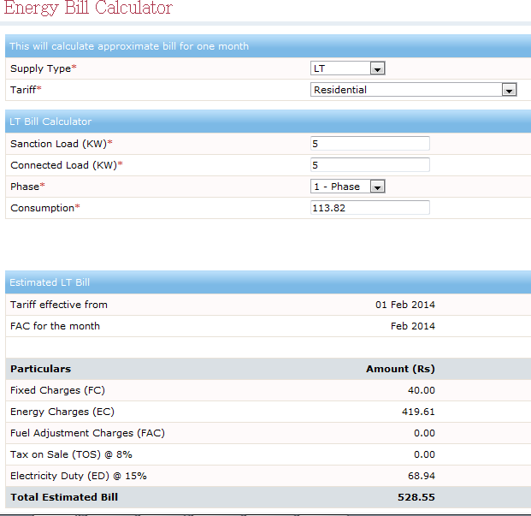
[1]
01 Feb 2020
Feb 2020

Slide 14
Annual saving Calculation
Sr. no | Type of energy saving options | Kwh/day consumption | Kwh/ month consumption | Kwh/year consumption | Annual savings (Rs) 5th coloumn* Rs 4.16/kwh
1 | Before investment measures | 5.663 | 169.89 | 2066.995 | 8600
2 | No investment Measures (immediate) | 5.256 | 157.68 | 1918.44 | 7981
3 | Low investment measures | 3.794 | 113.82 | 1384.81 | 5761
4 | High investment measures (long term) | - | - | - | -

Slide 15
Other Scope for saving energy consumption
Using natural resources as primary one
Open Windows &Doors-
This may reduce fan and tube light usage by 1 hr.
Sr.No | Appliances | Watt | Quantity | Use in hr. per day | Unit consumption per month | Charges per month
1 | Fan | 50 | 2 | 2 | 6 | 6*4.16 = 24.96
2 | Tube light | 20 | 3 | 5 | 9 | 9*4.16= 37.44

Slide 16
2) LED bulbs
Sr.No | Appliance s | Watt | Quantity | Use in hr. per day | Unit consumption per month | Charges per month
1 | LED | 6 | 2 | 0.5 | 0.18 | 0.18*4.16 = 1
Unplug all unused items and switch off appliances whenever not needed [3]
like TV, Charger, terrace & bathroom bulbs, fans etc.
Avoid combined electric meters
(0 to 100 units = 4.16 Rs
101 to 300 units = 7.39 Rs)
Use star rated appliances [2]
Maintenance/replacement of appliances consuming high electricity

Slide 17

CONCLUSION
Mentioned alternatives options reduces the consumptions of electricity by 56.07 units/month and simultaneously reduces charges by 233 Rs/month.

